Slide 1


CS 2200
LAB 13
Last Lab Woooooo

Slide 2
Announcements
Project 5 is released and is due April 24th @ 11:59 PM
Exam 4
Section B: April 30th @ 2:40-3:55pm
Sections A: May 2nd @ 11:20-12:35pm
Other makeups: Contact Kaylia to schedule ASAP
Project 4 Makeup Demos after lab today
Please fill out CIOS

Slide 3
APPLY TO BE A TA for Fall/Summer
https://ta-app.cc.gatech.edu
GATECH VPN IS REQUIRED FOR OFF-CAMPUS ACCESS
We also need summer TAs :)

Slide 4
Brief Overview:
Network Algorithms, Disk Architecture, Disk Scheduling Algorithms, File System Introduction

Slide 5
Network Layer — Overview
How do we get a package from the source to the destination?
Link State (LS) / Dijkstra’s Algorithm
Local algorithm with global information
All nodes have complete information about the state of the network
Each node can determine an optimal route
Requires each node to have perfect, updated knowledge of the entire network

Slide 6
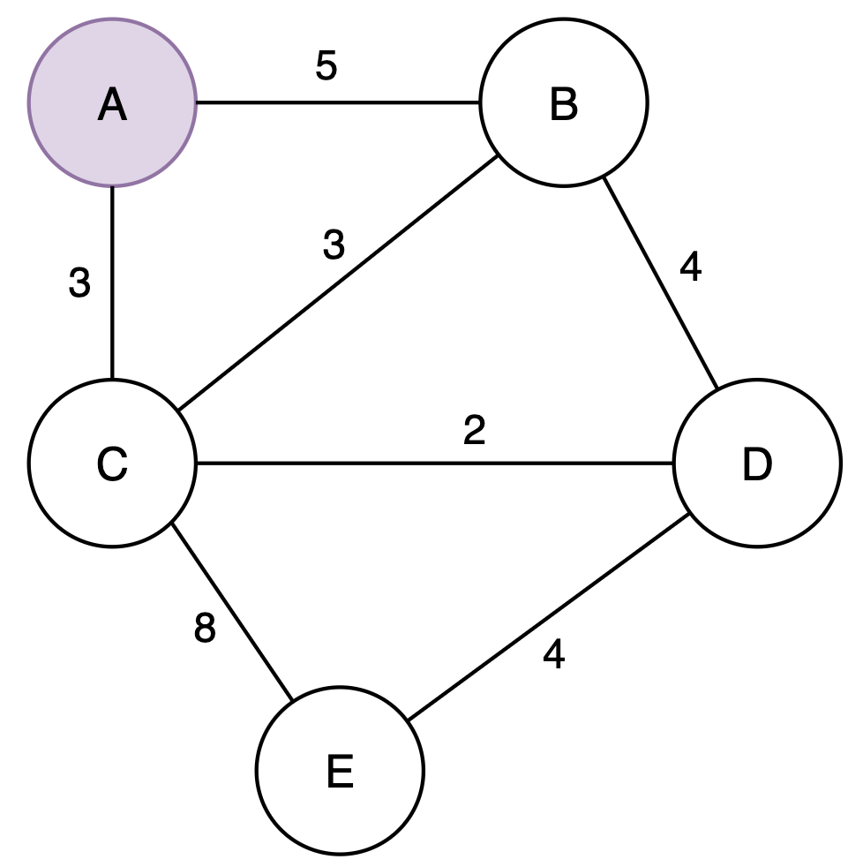
Link State Algorithm Example from Node A

Slide 7
Link State Algorithm Example from Node A
Iter | Traversed | B cost/route | C cost/route | D cost/route | E cost/route
0 | A | 5/AB | 3/AC | - | -
1
2
3
4

Slide 8
Link State Algorithm Example from Node A
Iter | Traversed | B cost/route | C cost/route | D cost/route | E cost/route
0 | A | 5/AB | 3/AC | - | -
1 | AC | 5/AB | 3/AC | 5/ACD | 11/ACE
2
3
4

Slide 9
Link State Algorithm Example from Node A
Iter | Traversed | B cost/route | C cost/route | D cost/route | E cost/route
0 | A | 5/AB | 3/AC | - | -
1 | AC | 5/AB | 3/AC | 5/ACD | 11/ACE
2 | ACB | 5/AB |  | 5/ACD | 11/ACE
3
4

Slide 10
Link State Algorithm Example from Node A
Iter | Traversed | B cost/route | C cost/route | D cost/route | E cost/route
0 | A | 5/AB | 3/AC | - | -
1 | AC | 5/AB | 3/AC | 5/ACD | 11/ACE
2 | ACB | 5/AB |  | 5/ACD | 11/ACE
3 | ACBD |  |  | 5/ACD | 9/ACDE
4

Slide 11
Link State Algorithm Example from Node A
Iter | Traversed | B cost/route | C cost/route | D cost/route | E cost/route
0 | A | 5/AB | 3/AC | - | -
1 | AC | 5/AB | 3/AC | 5/ACD | 11/ACE
2 | ACB | 5/AB |  | 5/ACD | 11/ACE
3 | ACBD |  |  | 5/ACD | 9/ACDE
4 | ACBDE |  |  |  | 9/ACDE

Slide 12
Initial State - Distance Vector Example
 | Distance to Node
Info at Node | A | B | C | D | E
A | 0 | 5 | 3
B | 5 | 0 | 3 | 4
C | 3 | 3 | 0 | 2 | 8
D |  | 4 | 2 | 0 | 4
E |  |  | 8 | 4 | 0

Slide 13
C sends vector to A - Distance Vector Example
 | Distance to Node
Info at Node | A | B | C | D | E
A | 0 | 5 | 3 | 5 | 11
B | 5 | 0 | 3 | 4
C | 3 | 3 | 0 | 2 | 8
D |  | 4 | 2 | 0 | 4
E |  |  | 8 | 4 | 0

Slide 14
C sends vector to E - Distance Vector Example
 | Distance to Node
Info at Node | A | B | C | D | E
A | 0 | 5 | 3 | 5 | 11
B | 5 | 0 | 3 | 4
C | 3 | 3 | 0 | 2 | 8
D |  | 4 | 2 | 0 | 4
E | 11 | 11 | 8 | 4 | 0

Slide 15
Final State - Distance Vector Example
 | Distance to Node
Info at Node | A | B | C | D | E
A | 0 | 5 | 3 | 5 | 9
B | 5 | 0 | 3 | 4 | 8
C | 3 | 3 | 0 | 2 | 8
D | 5 | 4 | 2 | 0 | 4
E | 9 | 8 | 6 | 4 | 0

Slide 16
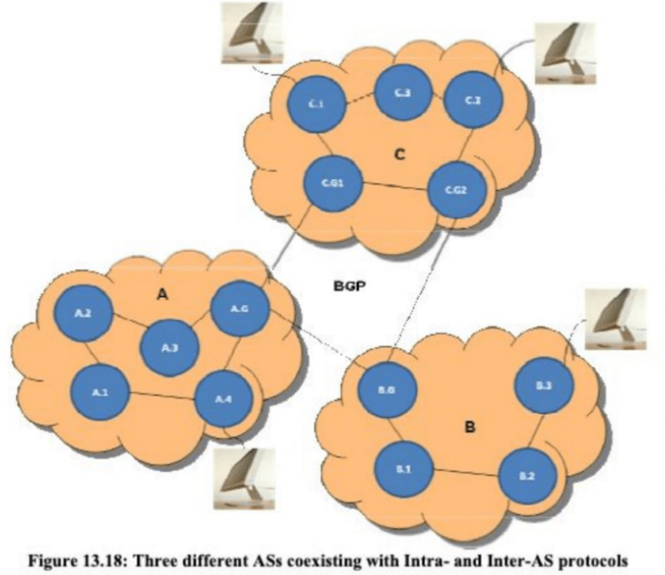
Network Algorithms, cont’d
Both aforementioned algorithms treat neighbors as peers — but the Internet has millions of nodes, so this isn’t going to scale.
Idea: subdivide the internet into Autonomous Systems (ASs), where each one can only see the nodes in the system instead of the entire network.
Called hierarchical routing.
Gateway routers can then communicate to other ASs using the Border Gateway Protocol (BGP).

Slide 17
Programmed IO & DMA

Slide 18
Introduction to I/O
Up until this point in the course, we have designed a machine that can interact with other machines, not with humans.
No inputs or outputs == no keyboards, mouse, monitor…
Device controllers
Uses generic interface to the CPU that does not require too much extra work
Uses specific interface to the device, that is part of the device controller
Memory-mapped I/O!
Uses special memory locations for the CPU and controller to talk to each other (very high addresses, like 0xFF00000);
What about cache?
Device driver - part of OS that issues commands to controllers
Computer
Device Controller
External I/O Device

Slide 19
Programmed I/O
Interact with devices through special memory addresses, MMIO.
loads/stores to do I/O!
Ex.: Controller sets ready bit in status register, CPU reads data register and clears ready bit
Polls the memory location to check the flags, aka if the data is ready
Very inefficient! Can require polling thousands or millions of times per input
Can be improved somewhat with interrupts (interrupt handlers to do device interaction!)
Best for slow speed devices that give data asynchronously (i.e. not tied to a clock)
Ex.: Keyboard and mouse

Slide 20
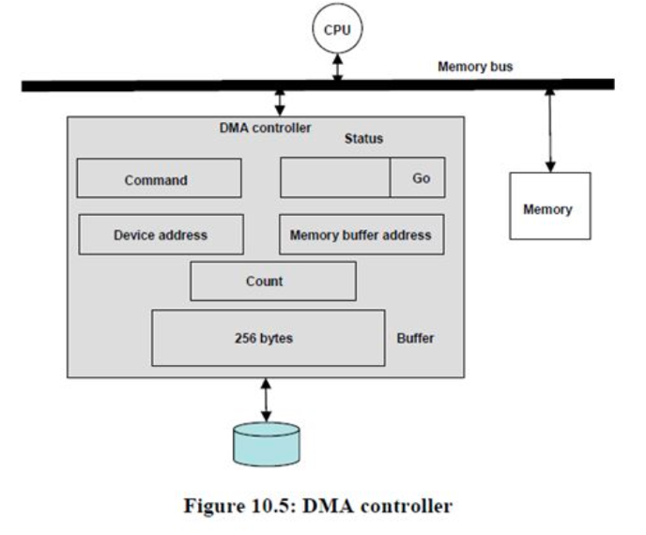
Direct Memory Access (DMA)
Transfer data to/from memory without going through the processor
CPU tells DMA controller what to do, DMA does memory accesses directly
Write to registers (memory locations) in DMA controller:
Transfer byte count
Memory buffer address
Device address
Command
Status (Go)

Slide 21
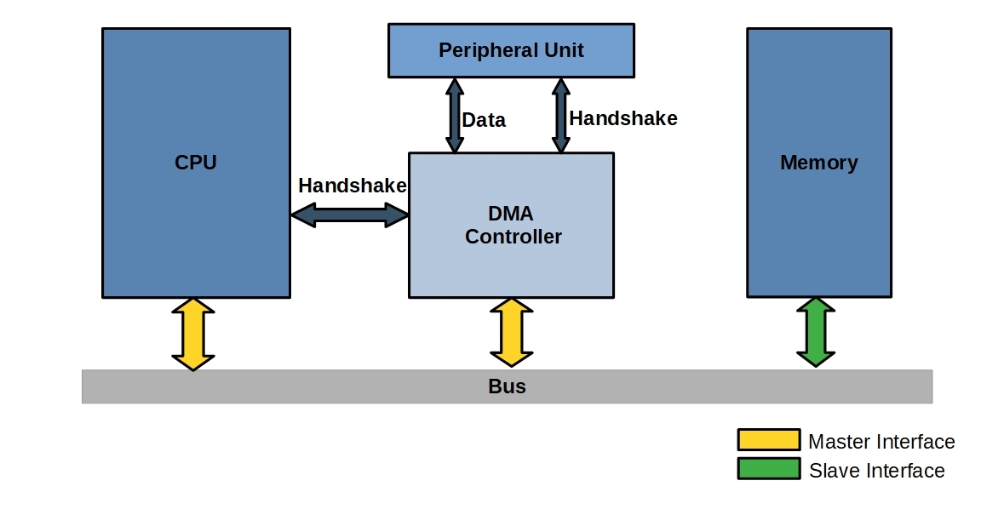
DMA Data Transfer

Slide 22
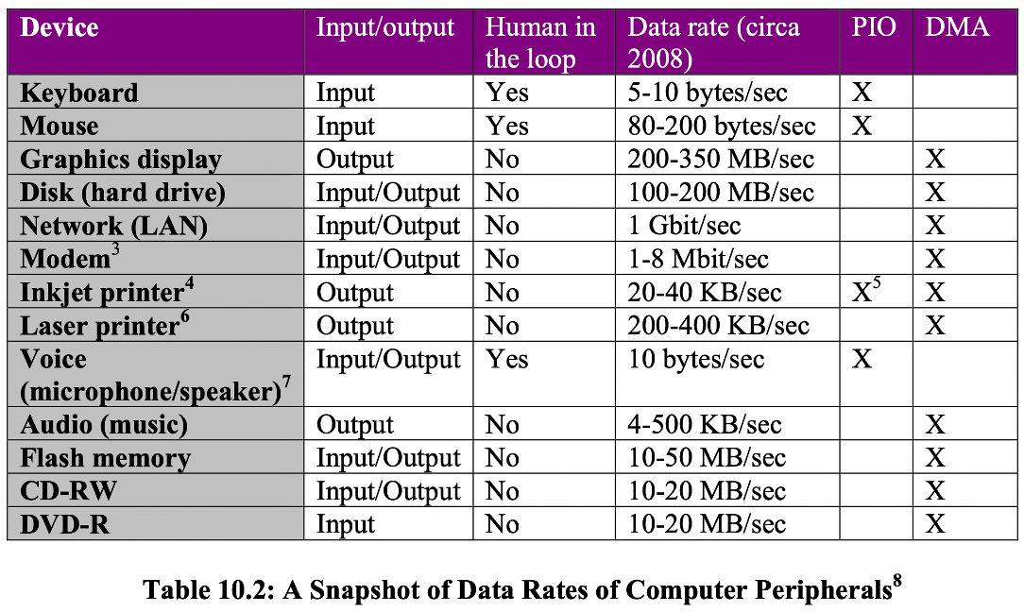
PIO vs DMA

Slide 23
Disks

Slide 24
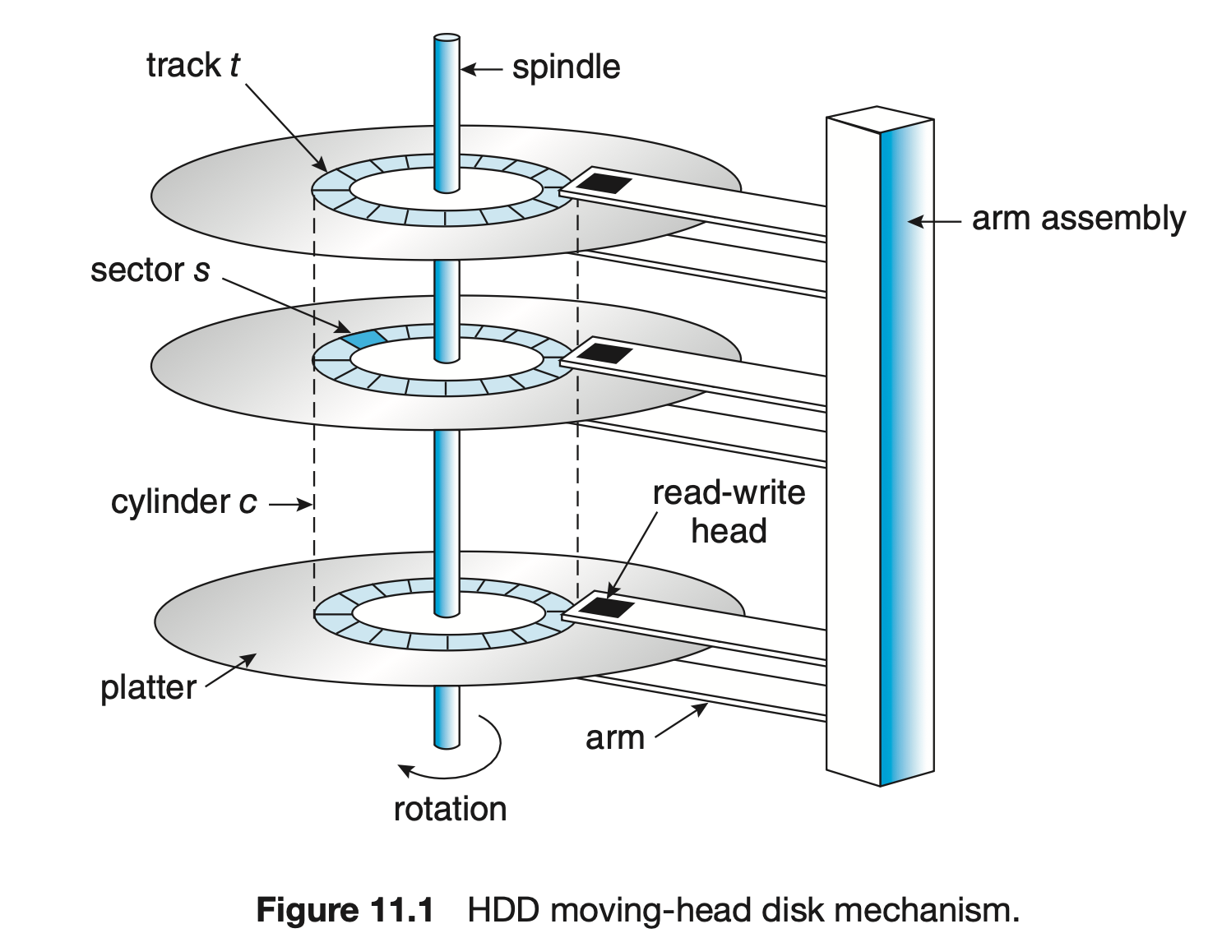
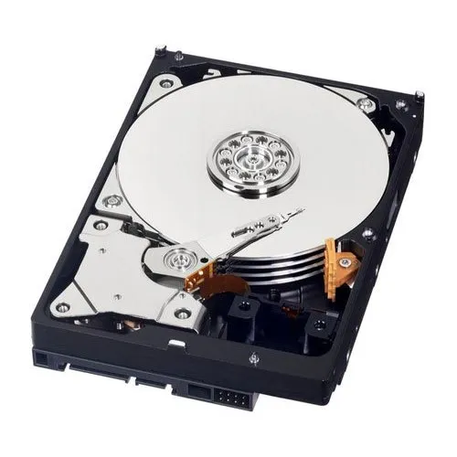
Hard Disk Drive

Slide 25
Hard Disk Drive
Platters each with two surfaces
Each platter has concentric tracks around the center spindle
Tracks are broken up into sectors
Sector are the fundamental unit of recording on a disk
contiguous recording of bytes of information
Magnetic read/write heads
do not touch the surfaces
all are connected to the same shaft using arms to form the head assembly
“Logical cylinder” is the set of corresponding tracks on all surfaces

Slide 26
Hard Disk Drive Calculations
p: # of platters
n: # of surfaces on plate (1 or 2)
t: # of tracks per surface
s: # of sectors per track
b: # of bytes per sector
Disk Capacity: p * n * t * s * b

Slide 27
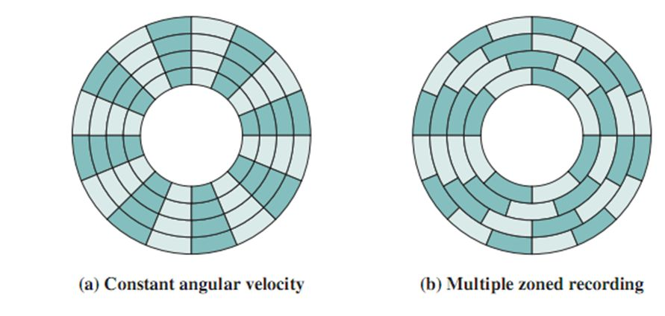
Disk Sectors & Zoning
Different tracks have different numbers of sectors
Tracks with the same number of sectors are in the same zone
New capacity formula:
p ∗ n ∗ (∑(t_i∗s_i)) ∗ b bytes for each zone i having t_i tracks, each with s_i sectors per track
Data transfer rate formula
is the same, but is now per-zone
Data stored on outer shells has
higher data transfer rate

Slide 28
Disk Drive Metrics
Seek time: time to move the head to the right cylinder
Rotational latency: time to spin the disk to get the right sector under the head
Data transfer time: time to transfer data between the head and the disk
Sector read time - amount of time it takes to read a single sector
Data transfer rate = (s * b * r) / 60 [bytes/second]
p = # of platters
n = # of surfaces per platter
t = # of tracks per surface
s = # of sectors per track
b = # of bytes per sector
r = rotation speed of disk in RPM

Slide 29
Disk Performance
A typical HDD stats:
Double side recording
7200 RPM
4096 Bytes per sector
204 sectors per track
2^20 = 1048576 tracks
per surface
8 Platters
2 Surfaces per platter
What’s the total capacity of this hard drive?

Slide 30
Disk Performance
A typical HDD stats:
Double side recording
7200 RPM
4096 Bytes per sector
204 sectors per track
2^20 = 1048576 tracks
per surface
8 Platters
2 Surfaces per platter
What’s the total capacity of this hard drive?
4096*204*1048576*8*2 = 14018773254144 Bytes
= 14018 GB ≈ 14TB
What is the transfer rate of this hard drive?

Slide 31
Disk Performance
A typical HDD stats:
Double side recording
7200 RPM
4096 Bytes per sector
204 sectors per track
2^20 = 1048576 tracks per surface
8 Platters
2 Surfaces per platter
What’s the total capacity of this hard drive?
4096*204*1048576*8*2 = 14018773254144 Bytes
= 14018 GB ≈ 14TB
What is the transfer rate of this hard drive?
Time for one rotation: 1 round / (7200round/min) = 1min/7200
= 60s/7200 = (1/120) s
Amount of data in one track: 4096 * 204 = 835584 Bytes
Amount of data in one cylinder: 835584 * 8 * 2 = 13369344 B
Transfer rate = data per cylinder / time to spin one cycle
= 13369344 Byte / (1/120) s = 1604321280 Byte/s
= 1530 MB/s

Slide 32
Disk Performance
A typical HDD stats:
Double side recording
7200 RPM
4096 Bytes per sector
204 sectors per track
2^20 = 1048576 tracks per surface
8 Platters
Avg Seek Time: 7.5ms
What is the transfer rate of this hard drive?
Time for one rotation: 1 round / (7200round/min) = 1min/7200
= 60s/7200 = (1/120) s
Amount of data in one track: 4096 * 204 = 835584 Bytes
Amount of data in one cylinder: 835584 * 8 * 2 = 13369344 B
Transfer rate = data per cylinder / time to spin one cycle
= 13369344 Byte / (1/120) s = 1604321280 Byte/s = 1530 MB/s
How long does it take to access a random block on the disk?

Slide 33
Disk Performance
A typical HDD stats:
Double side recording
7200 RPM
4096 Bytes per sector
204 sectors per track
2^20 = 1048576 tracks per surface
8 Platters
Avg Seek Time: 7.5ms
What is the transfer rate of this hard drive?
Time for one rotation: 1 round / (7200round/min) = 1min/7200
= 60s/7200 = (1/120) s
Amount of data in one track: 4096 * 204 = 835584 Bytes
Amount of data in one cylinder: 835584 * 8 * 2 = 13369344 B
Transfer rate = data per cylinder / time to spin one cycle
= 13369344 Byte / (1/120) s = 1604321280 Byte/s = 1530 MB/s
How long does it take to access a random block on the disk?
Rotational latency = time for one rotation = 1/120 s = 8ms
Average rotational latency = (1/120) /2 = (1/240) s = 4ms
Random access time = seek time + average rotational latency
= 7.5ms + (1/120)/2 s = 7.5ms + 4ms = 11.5ms

Slide 34
Disk Performance
A typical HDD stats:
Double side recording
7200 RPM
4096 Bytes per sector
204 sectors per track
2^20 = 1048576 tracks per surface
8 Platters
Avg Seek Time: 7.5ms
How long does it take to access a random block on the disk?
Rotational latency = time for one rotation = 1/120 s = 8ms
Average rotational latency = (1/120) /2 = (1/240) s =4ms
Random access time = seek time + average rotational latency
= 7.5ms + (1/120)/2 s = 7.5ms + 4ms = 11.5ms
Why do we divide rotational latency by 2 for average rotational latency?

Slide 35
Disk Performance
A typical HDD stats:
Double side recording
7200 RPM
4096 Bytes per sector
204 sectors per track
2^20 = 1048576 tracks per surface
8 Platters
Avg Seek Time: 7.5ms
How long does it take to access a random block on the disk?
Rotational latency = time for one rotation = 1/120 s = 8ms
Average rotational latency = (1/120) /2 = (1/240) s = 4ms
Random access time = seek time + average rotational latency
= 7.5ms + (1/120)/2 s = 7.5ms + 4ms = 11.5ms
Why do we divide rotational latency by 2 for average rotational latency?
On average, it takes half a cycle for the head to move to the target sector.
Best case: the head just happens to land on target sector
Worst case: the head just missed the beginning of target

Slide 36
Disk Performance
A typical HDD stats:
WD Ultrastar DC530
Double side recording
7200 RPM
204 sectors per track
Seek: 7.5ms
Rotation Latency: 8ms
Surface Size: 1.75TB
Total Capacity: 14TB
How long does it take to access a random block of data (sector) on the disk?
Random access time = seek time + average rotational latency
= 7.5ms + (1/120)/2 s = 7.5ms + 4ms = 11.5ms
Roughly how many random reads can this disk do per second?

Slide 37
Disk Performance
A typical HDD stats:
WD Ultrastar DC530
Double side recording
7200 RPM
204 sectors per track
Seek: 7.5ms
Rotation Latency: 8ms
Surface Size: 1.75TB
Total Capacity: 14TB
How long does it take to access a random block of data (sector) on the disk?
Random access time = seek time + average rotational latency
= 7.5ms + (1/120)/2 s = 7.5ms + 4ms = 11.5ms
Roughly how many random reads can this disk do per second?
(1000ms/(11.5ms+8ms/204))/1s = 86.67 reads/s
What’s the data transfer rate if all reads are in 4KB?

Slide 38
Disk Performance
A typical HDD stats:
WD Ultrastar DC530
Double side recording
7200 RPM
204 sectors per track
Seek: 7.5ms
Rotation Latency: 8ms
Surface Size: 1.75TB
Total Capacity: 14TB
How long does it take to access a random block of data (sector) on the disk?
Random access time = seek time + average rotational latency
= 7.5ms + (1/120)/2 s = 7.5ms + 4ms = 11.5ms
Roughly how many random reads can this disk do per second?
(1000ms/(11.5ms+8ms/204))/1s = 86.67 = 87 reads/s
What’s the data transfer rate if all reads are in 4KB?
87 * 4096 = 356352 Bytes/s = 348 KB/s
In fact, for sequential access, this disk can reach 255MB/s. Why is 4K random access slower than sequential access?

Slide 39
Solid State Drives (SSD)
You probably don’t have a hard disk in your laptop – instead, you have a more modern long-term storage medium, the solid state drive (SSD)
Faster but more expensive than hard disks (though personal-use-scale costs have decreased rapidly over the past decade)
Much higher I/O operations per second & max transfer rate, along with very low seek time and energy use as compared to hard disks
They use technology similar to ROMs–no spinning hardware! Just electrical signals

Slide 40
Disk Scheduling Algorithms
Goal of a disk scheduling algorithm:
Minimize access time
Minimize seek time & rotational latency
Move the head the least from disk request to disk request
Similar metrics to process scheduling:
Throughput -- number of I/O requests executed per time interval T
(Average) turnaround time -- (average) time it takes an I/O request to complete
Average waiting time -- average waiting time an I/O request experiences
Starvation -- occurs when a particular I/O request is consistently denied execution due to an intrinsic property of the I/O scheduler

Slide 41
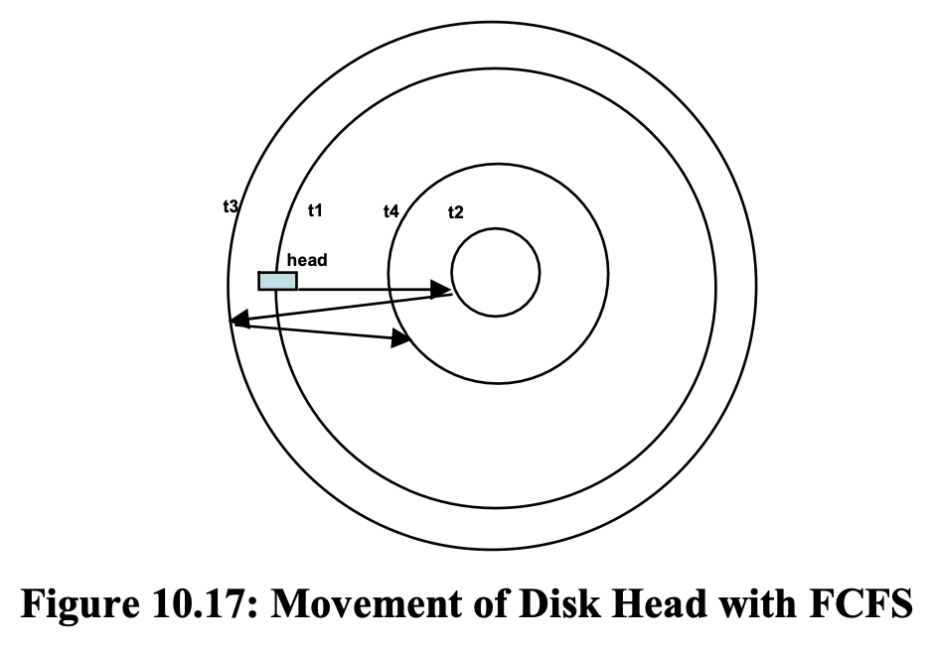
First Come First Serve
Services requests in order of arrival
Least variance in waiting time
...because it’s very slow
Remember, you need to move the magnetic head physically to service a read/write, and thus the further the total distance traveled, the longer seek time it takes to get aligned with the target cylinder.

Slide 42
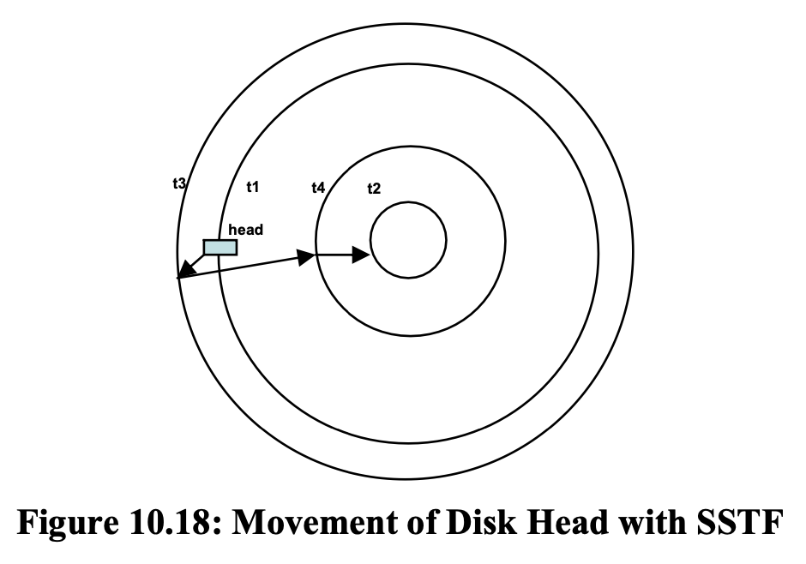
Shortest Seek Time First
Minimizes head movement
Short waiting times and good throughput, but high variance
Doesn’t preserve order of hard drive accesses
Leads to starvation if a disk access is far away from other

Slide 43
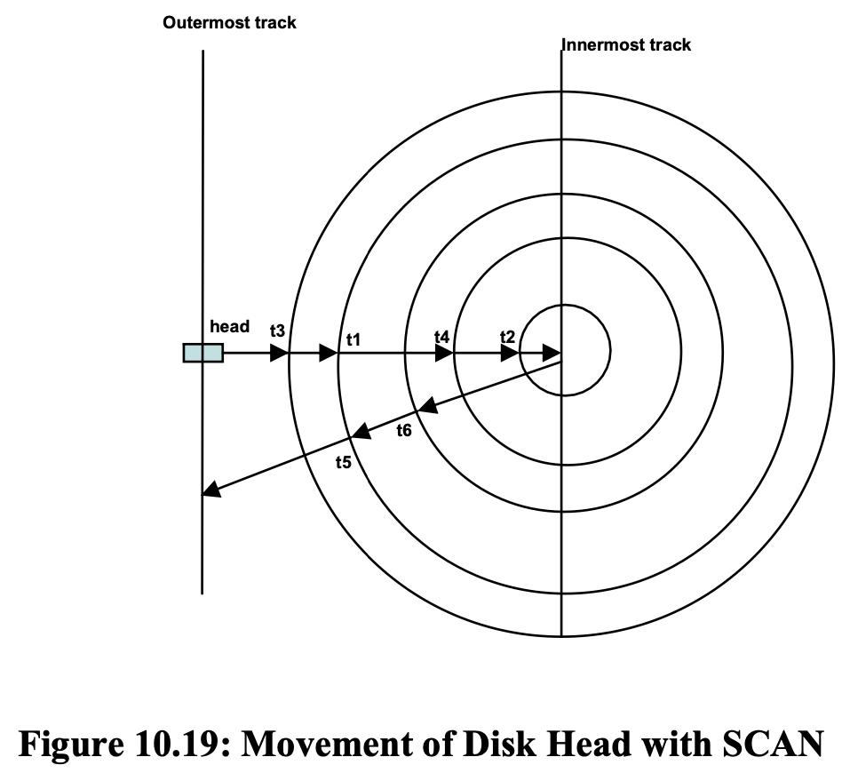
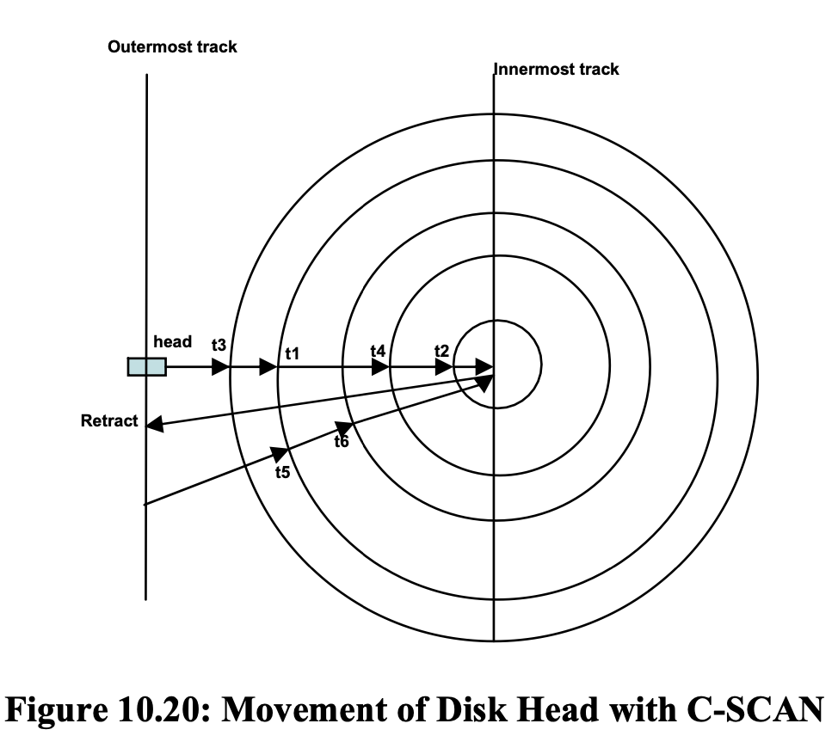
SCAN & C-SCAN
SCAN (elevator algorithm)
Head moves from outermost to innermost track
Handles requests en route
Once at the innermost, the head tracks back out
Repeats until queue is empty
Good wait times, throughput; limited starvation
Doesn’t preserve memory access ordering
Circular SCAN (C-SCAN)
SCAN, but doesn’t service requests on the return trip
Reduces bias for innermost tracks less variance in waiting time

Slide 44
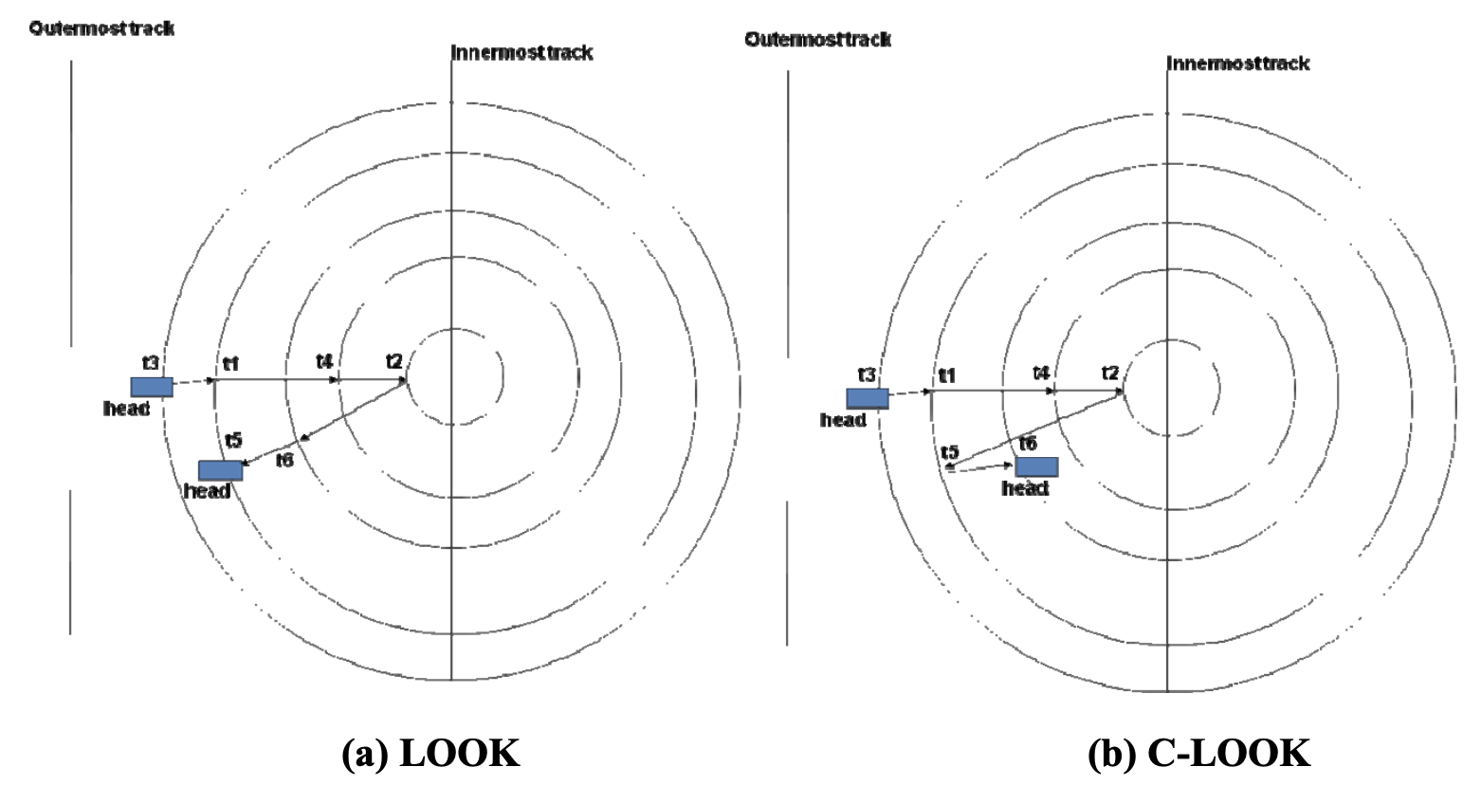
LOOK & C-LOOK
Very similar to SCAN and C-SCAN
Difference: when there are no more requests to be served in a particular direction, we reverse direction
No reason to go all the way out
if there are no requests to serve
Typically, some variant of
this is used in disks

Slide 45
File Systems

Slide 46

What do file systems provide?
Resemble the file "cabinet"
Similar to a physical filing cabinet!
Each file is a collection of information with attributes associated with the information.
Is an abstraction to actual layout
A process is the software abstraction for the processor
A data structure is the software abstraction for memory
A file is the software abstraction for an I/O device since a device serves as either a source or a sink for information.

Slide 47
File Attributes (Metadata)
Metadata represents space overhead and requires careful analysis as to its utility.
Examples:
Name: allows logically identifying the contents of a file.
Single-level naming scheme: names must be unique
Two-level: User -> Specific file
Multi-level dictionary: each part of the name is unique only with respect to the previous parts of the name. Gives a “tree” structure to the organization
Access Rights: who has access to a particular file and what kind of privilege each allowed user enjoys.
Read, write, execute, change ownership, change privileges

Slide 48
Unix file commands
touch - create a new file
mkdir - create a new directory
rm - remove file or directory with -r
ln - create a link to a file
-s soft link
chown / chmod - change owner or access mode to a file or directory
cp - copy file
mv - move a file
cat - print a file

Slide 49

EVERYTHING IS A FILE
One of the most important design decisions of the UNIX system that “everything is a file”
Any I/O resource such as documents, directories, hard-drives, keyboards, printers, monitors, terminals and even some inter-process communication is abstracted as a file. Interaction with these resources can be done exactly the same was as reading or writing to a file, and this abstraction is managed by the OS!

Slide 50
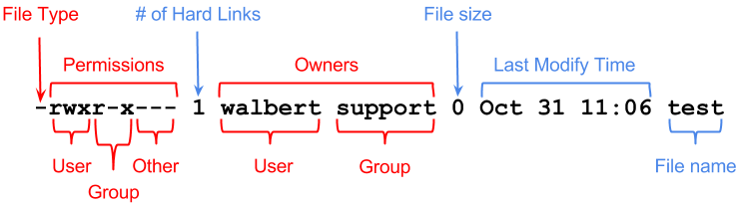
Displaying File Properties
Use ls -l
It also prints out i-node number, which will be covered more in-depth in File System

Slide 51
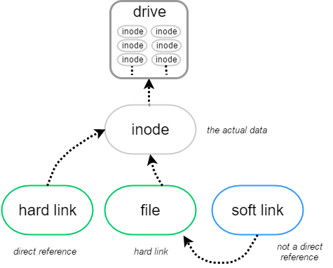
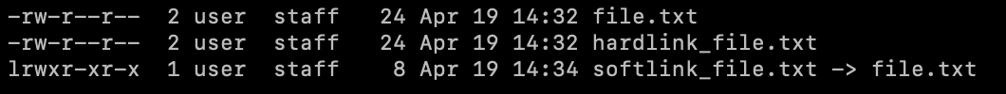
Soft link vs Hard link
Hard links points a file to the inode in the drive
Delete a single hard link will not erase the file, since there is yet another link that points to the original inode
Soft / Symbolic links is just an indirection that points a file to another file
If the original file is deleted, the link becomes dangling

Slide 52
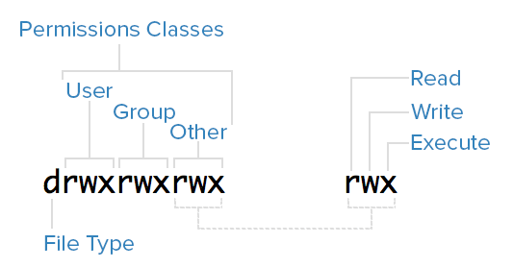
Unix File Access Privilege and chmod
Encoded with three octant number representing three permission classes, each representing Read, Write, Execute
Use chmod to change the privilege
For instance, chmod 744 filename.txt
gives read, write, and execute privilege to
the current user, which is basically you! It also
grants users in the same user group and all others the right to only read and write to the file.

Slide 53
chmod commands
You can also add certain privilege without overwriting other privileges.
For example, chmod +x filename.txt would only add execute privilege to all users.
You may also specify who gets execute privilege. chmod u+x filename.txt grants the user the execute privilege. Technically speaking, to set execute privilege to all users, you should use chmod a+x, where a stands for all.

Slide 54
chmod commands practice
Consider a following file with no access granted: ---------- file.txt
How do you give the current user all of read, write, and execute privilege?
What does chmod 644 file.txt mean? What would print out with ls -l?
How do you grant execute privilege to group only, without interfering other existing privilege?

Slide 55
chmod commands practice
Consider a following file with no privilege granted: ---------- file.txt
How do you give the current user all of read, write, and execute privilege?
chmod 700 file.txt
What does chmod 644 file.txt mean? What would print out with ls -l?
644 = 110 100 100 = rw-r--r--
How do you grant execute privilege to group only, without interfering other existing privilege?
chmod g+e file.txt

Slide 56
Filesystem Implementations
Contiguous Allocation
Linked Allocation
File Allocation Table (FAT)
Indexed Allocation
Multilevel Index Allocation
Hybrid Index Allocation
Note: We haven’t covered file system yet, so we may not cover the following slides during the lab. Feel free to ask your TA if you want to talk about it.

Slide 57
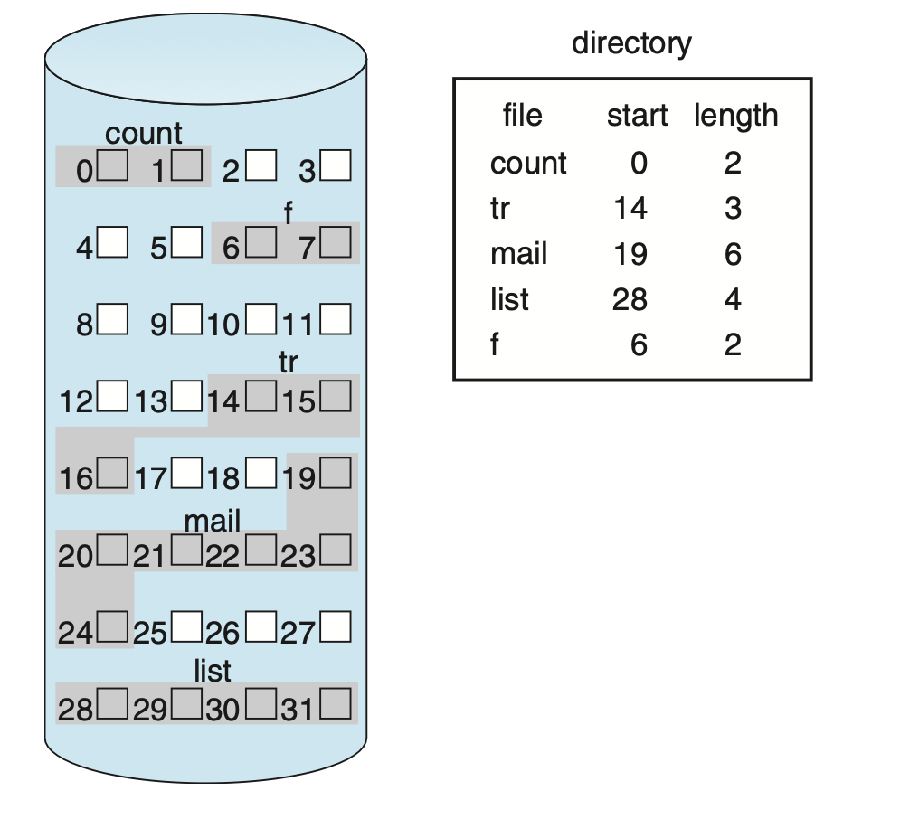
Contiguous Allocation
Maintains a “free list” of available disk blocks
Suffers from external fragmentation (just like variable size memory allocation)
Suffers from internal fragmentation (just like fixed size memory allocation)
Sequential access and random access to a file is efficient
The file cannot grow
Could move it to a bigger node in the freelist but expensive
Memory wasted due to fragmentation

Slide 58
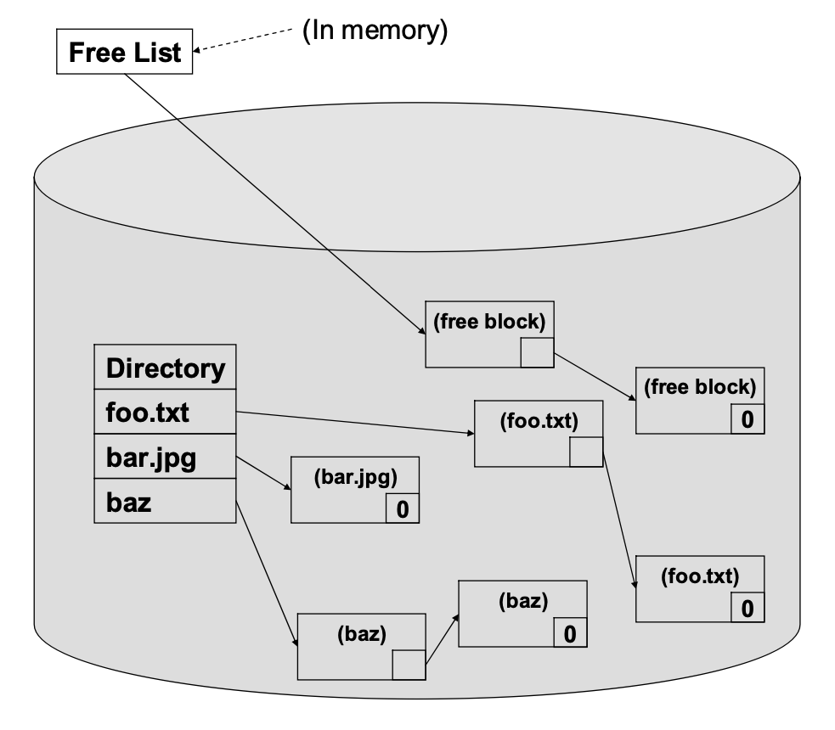
Linked Allocation
A file occupies as many disk blocks as it takes to store it on the disk
No fragmentation!
The file system allocates the disk blocks from the free list as the file grows
No fixed size files and expensive relocation
Allocation is quick since it is one disk block at a time
Just pop off the free list
Poor contiguous and random access
Blocks are not guaranteed to be sequential
Expensive and fault prone implementation
Freelist maintenance is expensive and potentially catastrophic to the entire system if done wrong

Slide 59
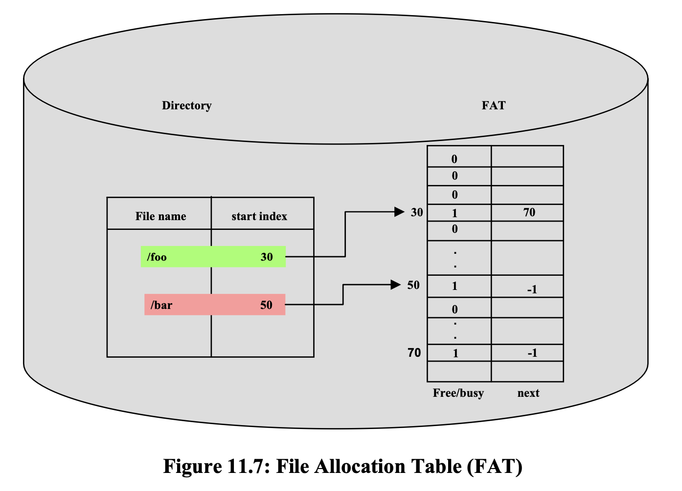
File Allocation Table (FAT)
Divides disk into partitions
Each partition gets its own FAT
Free/busy indicates availability
Next points to the next block in the linked list
Directory – file name to disk map

Slide 60
File Allocation Table (FAT)
Less error prone
Linked list is captured in the tabular data structure
FAT is cached in memory
Faster allocation time
Same performance for sequential access
Faster performance for random access
Creates artificial scarcity due to FAT being a fixed size

Slide 61
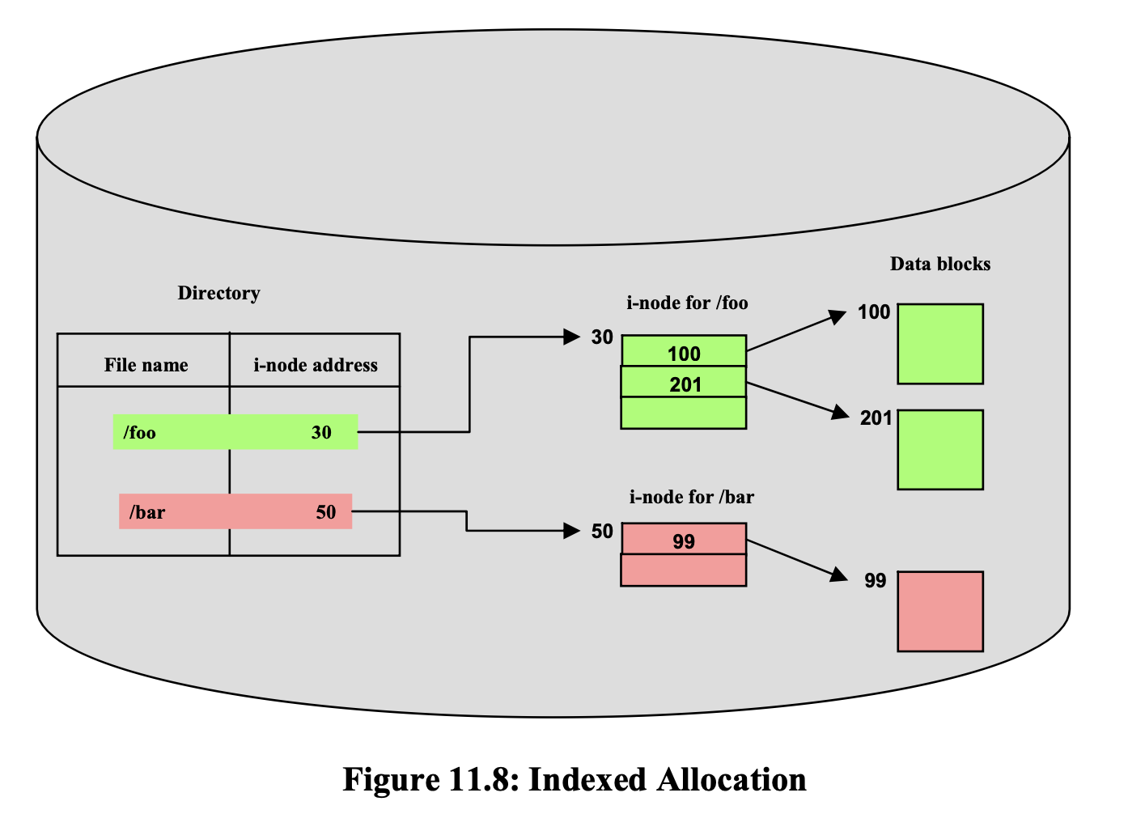
Indexed Allocation
This scheme allocates an index disk block for each file
The index block (inode) is a fixed-size data structure that contains addresses for data blocks that are part of that file.
Basically, the same as FAT
Performs better for random access:
inode aggregates all the disk block pointers into one concise data structure.
Limitation on the maximum size of a file:
inode is a fixed size data structure per file with direct pointers to data blocks

Slide 62
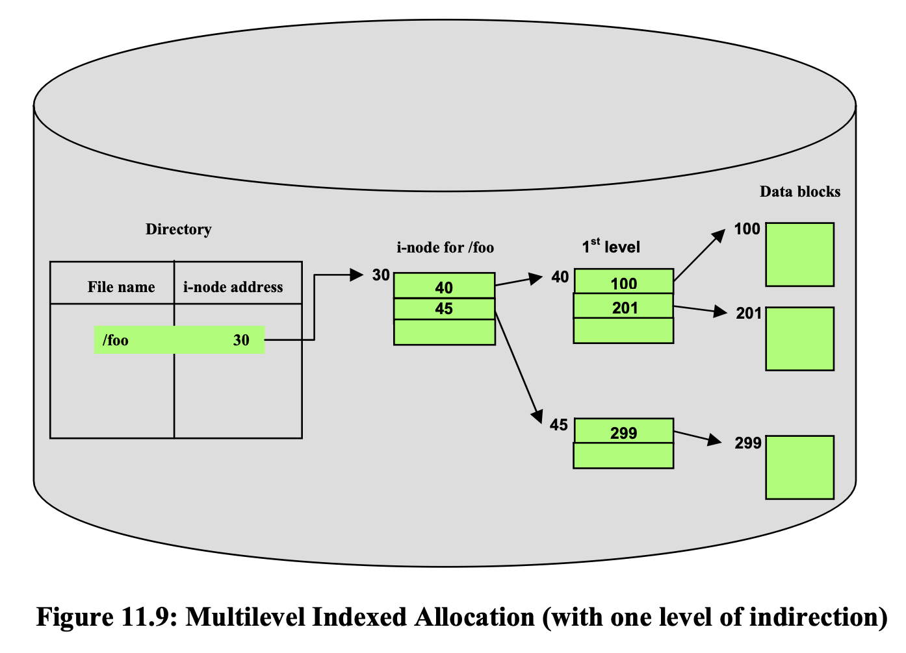
Multilevel Indexed Allocation
Fixes the limitation in the indexed allocation by making the inode for a file an indirection table
Bigger file sizes
Small files that may fit in a few data blocks have to go through extra levels of indirection.

Slide 63
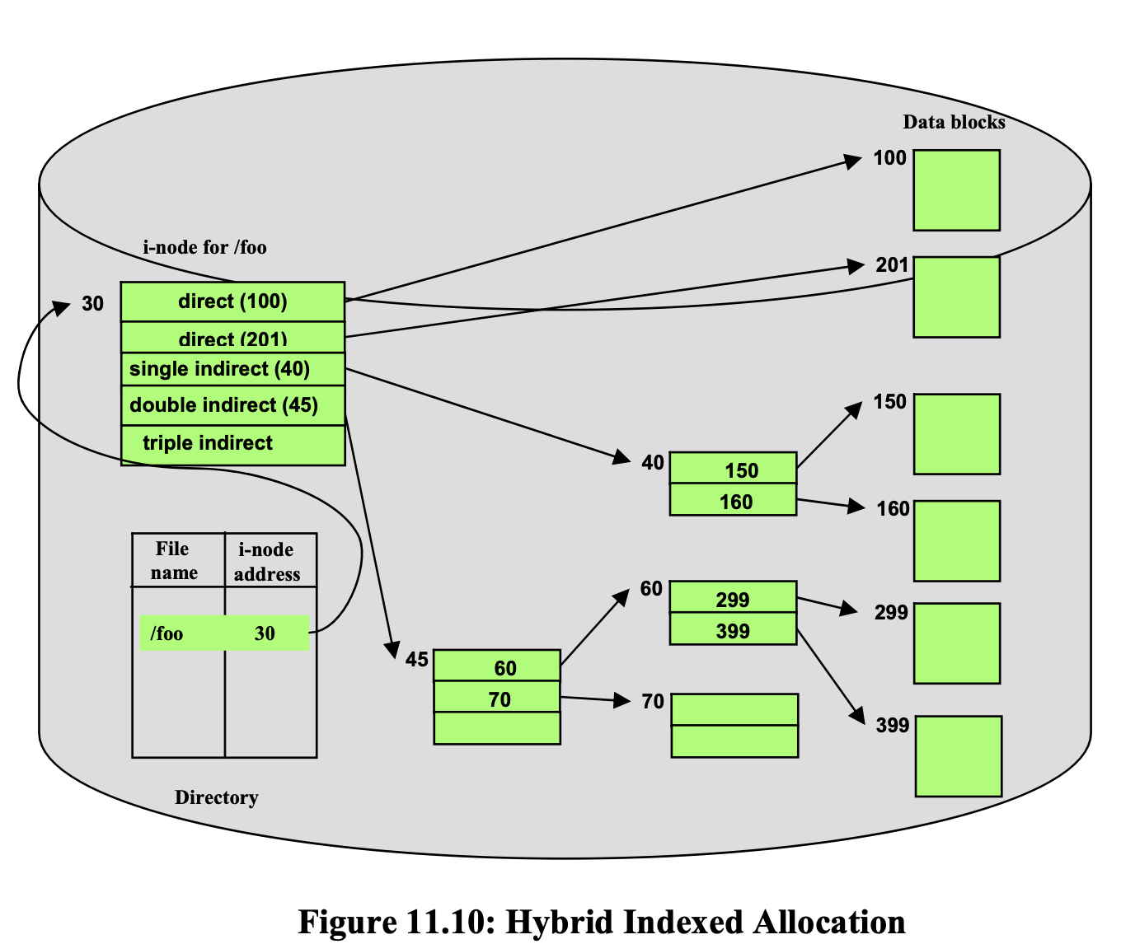
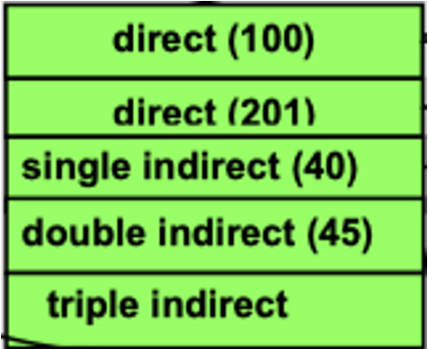
Hybrid Allocation (UNIX inodes)
i-nodes entries point to blocks either directly or indirectly
Accommodates all the data blocks for small file with direct pointers.
Keeps advantages of the previous indexed scheme

Slide 64
Exercise
Given the following:
Size of index block = 256 bytes
Size of Data block = 2048 bytes
Size of pointer = 8 bytes (to index or data blocks)
The i-node consists of
2 direct block pointers,
1 single indirect pointer, and
1 double indirect pointer.

Slide 65
Exercise
What is the maximum size of a file that can be stored in this file system ?

Slide 66
Exercise
What is the maximum size of a file that can be stored in this file system ?
Number of single indirect or double indirect pointers in an index block
= 256/8 = 32
Number of direct data blocks = 2

Slide 67
Exercise
What is the maximum size of a file that can be stored in this file system ?
Number of single indirect or double indirect pointers in an index block
= 256/8 = 32
Number of direct data blocks = 2
An i-node contains 1 single indirect pointer that points to an index block (we call this single indirect index block) containing pointers to data blocks. Number of data blocks with one level of indirection i.e. the number of data block pointers in an index block
= 32

Slide 68
Exercise
What is the maximum size of a file that can be stored in this file system ?
An i-node contains 1 single indirect pointer that points to an index block (we call this single indirect index block) containing pointers to data blocks. Number of data blocks with one level of indirection i.e. the number of data block pointers in an index block
= 32
An i-node contains 1 double indirect pointer that points to an index block (we call this double indirect index block) containing 32 single indirect pointers. Each such pointer point to a single indirect index block that in turn contains 32 pointers to data blocks. Number of data block with two levels of indirection i.e. number of single indirect pointers in an index block
= 32*32

Slide 69
Exercise
What is the maximum size of a file that can be stored in this file system ?
Max file size in blocks
= number of direct data blocks +
number of data blocks with one level of indirection +
number of data blocks with two levels of indirection
= 2 + 32+ 32*32 = 1058 data blocks = 1058 * 2048 bytes = 2,166,784 Bytes

Slide 70
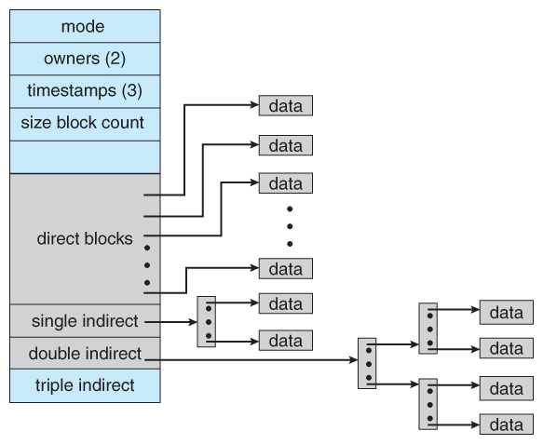
inode data structure

Slide 71

Thanks for Attending :)

